Slide 1

CSE3009 Parallel and Distributed Computing
G.GANESAN, B.E(CSE)., M.E(CSE)., M.S(IT)., MISTE., MIAENG.
ASSOCIATE PROFESSOR,
SCHOOL OF COMPUTING SCIENCE AND ENGINEERING,
VIT BHOPAL UNIVERSITY.
9500234437
ganesan.g@vitbhopal.ac.in

Slide 2

Content
  1. Parallel Algorithms
  2. Decomposition Techniques

Slide 3
1. Parallel Algorithms

Slide 4
Introduction
A parallel algorithm specifically written for execution on a computer with two or more processors.
- But it can be run on computers with single processors.
- Multiple functional units, Pipelined functional units,
Pipelined memory system.
A better algorithms has
- Throughput (the number of operations done per unit of time)
- Latency (Time needed to complete one operation.)

Slide 5
1.1 Problem Statement
The sequence of input size N is distributed across P processors.
The output is such that
* Elements in each processor P_{i} is sorted.
* Elements in P_{i} is greater than elements in P_{i-1} and lesser than elements P_{i+1}.

Slide 6
1.1 Algorithm-1
We use the Naïve Approach-1
Start with a single processor; divide into two sub-arrays
Now involve one more processor
Both the processors perform the next step of quick sort within their local subarrays.
And so on … till the number of subarrays equal the number of processors.
Disadvantage:
Inefficient utilization of processors.

Slide 7
1.2 Algorithm-2
Naïve Approach-1
All the processors in all the iterations.
One of the processors, P0, begins by broadcasting one of its elements as the Pivot element to all the processors.
Each processor then divides its local array into two sub-arrays.
- Li : elements less than the pivot
- Gi : elements greater than the pivot.

Slide 8
1.2 Algorithm-2
Processors are divided into two groups:
* First group will process the subsequent steps with L_{i}s
* Second group with G_{i}s
2. The sizes of the processor group must be in the ratio of
the number of elements in Ls and Gs to achieve load
balance.
3. These number of elements can be found using an all
reduce operation.

Slide 9
Shared Memory Implementation
All L’s are formed in the first part of the array; all G’s in the second part.
Each processor needs to know the locations in the shared memory where it has to write its L_{i} and G_{i}.
Prefix sums of the sizes of the sub-arrays can be used.
Prefix sum can be done in O(logP).

Slide 10
2. Decomposition Techniques

Slide 11
1. Recursive Decomposition
These techniques are broadly classified as recursive decomposition, data decomposition, exploratory decomposition, and speculative decomposition.
Recursive decomposition is a method for inducing concurrency in problems that can be solved using the divide-and-conquer strategy.
Divide and conquer strategy results in natural concurrency, as different sub problems can be solved concurrently.
Example Quicksort Consider the problem of sorting a sequence A of n elements using the commonly used quicksort algorithm.
Quicksort is a divide and conquer algorithm that starts by selecting a and pivot element x and then partitions the sequence A into two subsequences such that all the elements in are smaller than x and all the elements in are greater than or equal to x.

Slide 12
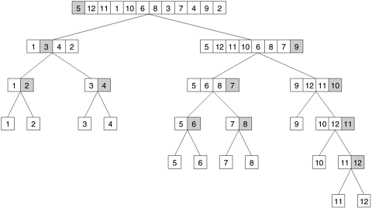
1. Recursive Decomposition
The partitioning step forms the divide step of the algorithm Each one of the subsequences is sorted by recursively calling quicksort. Each one of these recursive calls further partitions the sequences. This is illustrated in Figure for a sequence of 12 numbers.
The recursion terminates when each subsequence contains only a single element. The quicksort task-dependency graph based on recursive decomposition for sorting a sequence of 12 numbers.

Slide 13
1. Recursive Decomposition
The partitioning step forms the divide step of the algorithm Each one of the subsequences is sorted by recursively calling quicksort. Each one of these recursive calls further partitions the sequences. This is illustrated in Figure for a sequence of 12 numbers.
The recursion terminates when each subsequence contains only a single element. The quicksort task-dependency graph based on recursive decomposition for sorting a sequence of 12 numbers.

Slide 14
2. Data Decomposition
Data decomposition is a powerful and commonly used method for deriving concurrency in algorithms that operate on large data structures.
In this method, the decomposition of computations is done in two steps.
In the first step, the data is partitioned on which the computations has performed.
In the second step, this data partitioning is used to induce a partitioning of the computations into tasks.

Slide 15
3. Output Data Partitioning
In many computations, each element of the output can be computed independently of others as a function of the input.
In such computations, a partitioning of the output data automatically induces a decomposition of the problems into tasks, where each task is assigned the work of computing a portion of the output.

Slide 16
3. Output Data Partitioning
In many computations, each element of the output can be computed independently of others as a function of the input.
In such computations, a partitioning of the output data automatically induces a decomposition of the problems into tasks, where each task is assigned the work of computing a portion of the output.
For example:
Consider the problem of multiplying two n x n matrices A and B to yield a matrix C. The four sub matrices of C, roughly of size n/2 x n/2 each, are then independently computed by four tasks as the sums of the appropriate products of sub matrices of A and B.

Slide 17
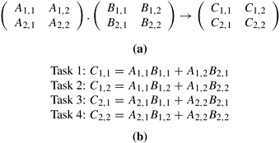
3. Output Data Partitioning
Partitioning of input and output matrices into 2 x 2 sub matrices.
A decomposition of matrix multiplication into four tasks based on the partitioning of the matrices in (a).

Slide 18
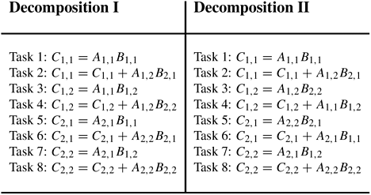
3. Output Data Partitioning
The two ways of decomposition of matrix multiplication into eight tasks are:

Slide 19
4. Input Data Partitioning
Partitioning of output data can be performed only if each output can be naturally computed as a function of the input.
A task is created for each partition of the input data and this task performs as much computation as possible using these local data.
Some decompositions for computing item set frequencies in a transaction database.

Slide 20
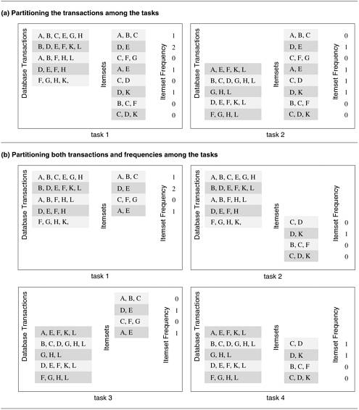
4. Input Data Partitioning

Slide 21
Input and Output Data Partitioning
In some cases, in which it is possible to partition the output data, partitioning of input data can offer additional concurrency.
Partitioning intermediate data Partitioning intermediate data can sometimes lead to higher concurrency than partitioning input or output data.

Slide 22
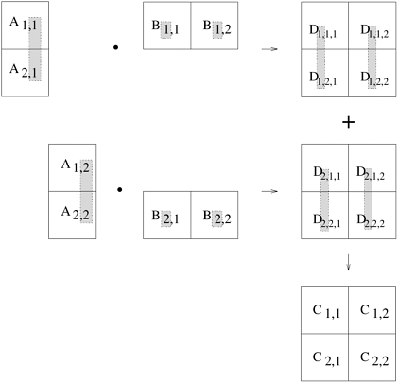
Input and Output Data Partitioning
Multiplication of matrices A and B with partitioning of the three-dimensional intermediate matrix D.

Slide 23
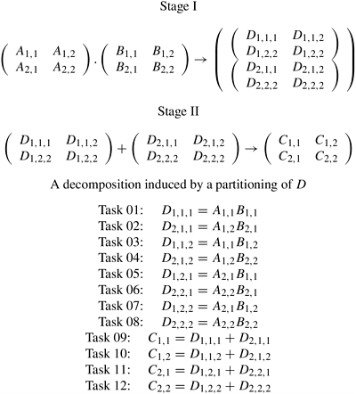
Input and Output Data Partitioning
The decomposition of Matrix Multiplication based on partitioning the intermediate three-dimensional matrix D.

Slide 24
5. Exploratory Decomposition
Exploratory decomposition is used to decompose problems whose underlying computations correspond to a search of a space for solutions.
In exploratory decomposition, the search space is partitioned into smaller parts, and search each one of these parts concurrently, until the desired solutions are found.

Slide 25
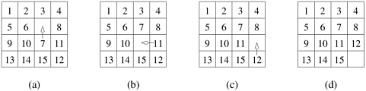
5. Exploratory Decomposition
15-puzzle problem instance showing
The initial configuration
(d) The final configuration
(b) & (c) A sequence of moves leading from the initial to the final configuration.

Slide 26
6. Speculative Decomposition
Speculative decomposition is used when a program may take one of many possible computationally significant branches depending on the output of other computations that precede it.
In this situation, while one task is performing the computation whose output is used in deciding the next computation, other tasks can concurrently start the computations of the next stage.
The speedup due to speculative decomposition can add up if there are multiple speculative stages.
An example of an application in which speculative decomposition is useful is discrete event simulation.

Slide 27
6. Speculative Decomposition
Parallel discrete event simulation
Consider the simulation of a system that is represented as a network or a directed graph.
The nodes of this network represent components. Each component has an input buffer of jobs. The initial state of each component or node is idle.
An idle component picks up a job from its input queue, if there is one, processes that job in some finite amount of time, and puts it in the input buffer of the components which are connected to it by outgoing edges.
A component has to wait if the input buffer of one of its outgoing neighbors if full, until that neighbor picks up a job to create space in the buffer. There is a finite number of input job types.

Slide 28
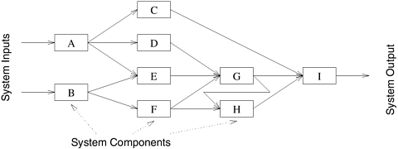
6. Speculative Decomposition

Slide 29
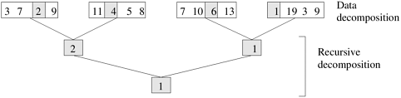
7. Hybrid Decomposition
A computation is structured into multiple stages and it is sometimes necessary to apply different types of decomposition in different stages.
Figure shows the Hybrid decomposition for finding the minimum of an array of size 16 using four tasks.

Slide 30
Discussion

